Slide 1
Java Database Connectivity…

Slide 2
Introduction to JDBC
Programs written in Java are able to communicate with relational databases (whether local or remote) via the Java Database Connectivity (JDBC) API
For the accessing of data from a particular type of relational database JDBC communicate with the vendor-specific API for that database referred to as a driver.
Drivers are usually supplied either by the database vendors themselves or by third parties.
Ex: ODBC is drivers were originally available only for Microsoft (MS) databases.

Slide 3
The Concept of JDBC
JDBC drivers created by DBMS manufacturer have to
Open a connection between the DBMS and the J2EE component
Translate low-level equivalents of SQL statement sent by the J2EE component into messages that can be processed by the DBMS
Return data that conforms to the JDBC specification to the JDBC driver
Close the connection between the DBMS and J2EE components.

Slide 4
7.1 The Vendor Variation Problem
A fundamental problem is variation in internal format of databases when it is required to give general access methods.
For example, the internal format of an Oracle database will be different from that of an Access database, while the format of a MySQL database will be different from both of these.
Driver software :
Mediating software that will allow JDBC to communicate with the vendor-specific API for particular database.
That is, between JDBC and a particular type of relational database, it is necessary to provide some mediating software referred to as a driver.
Suitable drivers are usually supplied either by the database vendors themselves or by third parties.
JAVA Database Connectivity (JDBC)

Slide 5
Microsoft had introduced its own solution to the problem of accessing databases that have different internal formats: Open Database Connectivity (ODBC).
Other vendors and third party suppliers have brought out ODBC drivers for most of the major non-MS databases.
Oracle provides the JDBC-ODBC bridge driver in package sun.jdbc.odbc , which is included in the Java Standard Edition.
This driver converts the JDBC protocol into the corresponding ODBC one and allows Java programmers to access databases for which there are ODBC drivers.
JAVA Database Connectivity (JDBC)

Slide 6
7.2 SQL and Versions of JDBC
The standard means of accessing a relational database is to use SQL (Structured
Query Language).
The core JDBC API is called java.sql.
The original JDBC that was released with JDK 1.1 was JDBC 1.0, which comprised
package java.sql .
Using this API, it is possible to access data not only from relational databases, but also from spreadsheets and flat files—i.e., from just about any data source.
With JDBC 2.0, which appeared in J2SE 1.4, extra functionality was introduced with the additional package javax.sql.
New feature of this version introduced the DataSource interface.
Which now provides the preferred method of making a connection to a database.
JAVA Database Connectivity (JDBC)

Slide 7
JDBC Drivers
Type1 (JDBC-ODBC Driver)
Type 2 (Java Native Code Driver)
Type 3 (Java Protocol)
Type 4 (Database Protocol)

Slide 8
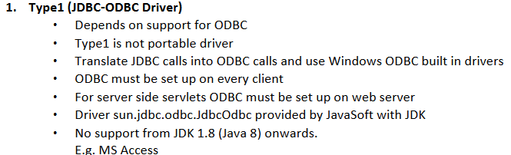

Slide 9
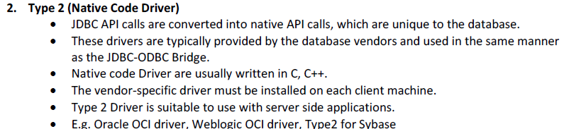

Slide 10
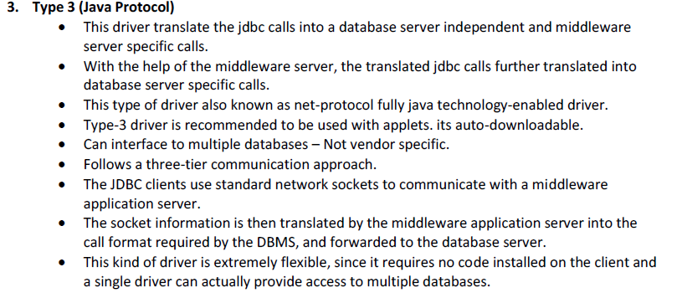

Slide 11
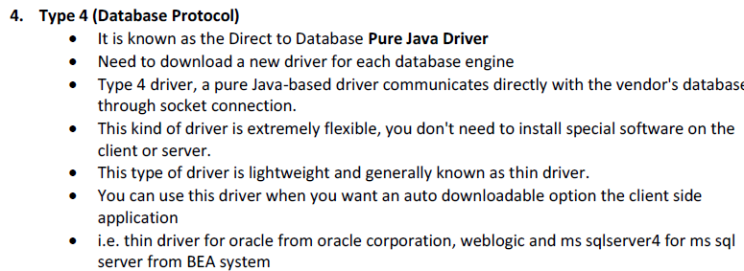

Slide 12
Creating an ODBC Data Source
Database as an ODBC Data Source
ODBC-driven database can be accessed via a Java program
Register the database as an ODBC Data Source
Database can be referred by its Data Source Name (DSN).
ODBC – Open DataBase Connectivity

Slide 13
Steps required to set up your own ODBC Data Source are shown below: (assuming that database is already created).
  1. Select start → Run…
  2. Enter cmd and click on OK.
  3. Enter C:\windows\syswow64\odbcad32.exe .
  4. Ensure that the User DSN tab is selected .
  5. Click on the Add… button to display the Create New Data Source window.
  6. Select MySql driver and click on Finish .
  (or Microsoft Access Driver (*.mdb, *.accdb))
7. To locate the required database within the directory structure, click on the
Select… button.
8. Navigate through the directory structure and select your database.
9. Supply a name for the data source. (‘Description’ field is optional.)

Slide 14
10. If specifying a username and password (not mandatory), click on Advanced
Options and key in the values, clicking OK when finished.
11. Click OK to finish registration.
N.B. Remember that the above procedure is required only for ODBC databases!

Slide 15
Simple Database Access

Slide 16
Using JDBC to access a database requires several steps
1. Load the database driver.
2. Establish a connection to the database.
3. Use the connection to create a Statement and store a reference to this object
4. Use the above Statement reference to run a specific query or update statement and accept the result(s)
5. Manipulate and display the results (if a query) or check/show number of database rows affected (for an update)
6. Repeat steps 4 and 5 as many times as required for further queries/updates.
7. Close the connection.

Slide 17
1.Load the Database Driver
This is achieved via static method forName of class Class
Class.forName("com.mysql.jdbc.Driver")
2.Establish a Connection to the Database
Method getConnection takes three String arguments:
a URL-style address for the database
a user name;
a password.
Connection con =DriverManager.getConnection("jdbc:mysql://localhost/database1","root", “root");

Slide 18
3.Create a Statement Object and Store its Reference
A Statement object is created by calling the createStatement method of our Connection object
Create Statement is saved in a Statement reference
Statement stm = con.createStatement ( );

Slide 19
4.Run a Query/Update and Accept the Result(s)
DML (Data Manipulation Language) statements in SQL may be divided into two categories:
Those that retrieve data from a database (i.e., SELECT statements)
and
Those that change the contents of the database in some way (INSERT, DELETE and UPDATE statements)
Class Statement has methods executeQuery and executeUpdate that are used to execute these two categories respectively
The former method returns a ResultSet object, while the latter returns an integer that indicates the number of database rows that have been affected by the updating operation

Slide 20
Example 1:
String selectAll = "SELECT * FROM Accounts";
ResultSet results =stm.executeQuery(selectAll);
Example 2:
String selectFields = "SELECT acctNum, balance FROM Accounts";
ResultSet results = stm.executeQuery(selectFields);
Example 3
String selectRange = "SELECT * FROM Accounts WHERE balance >= 0 AND balance <= 1000 ORDER BY balance DESC";
ResultSet results = stm.executeQuery(selectRange);

Slide 21
5.Manipulate/Display/Check Result(s)
The ResultSet object returned in response to a call of executeQuery contains the database rows that satisfy the query's search criteria
Having moved to the particular row of interest via any of the methods, we can retrieve data via either the field name or the field position
int getInt (String <columnName>)
int getInt (int <columnIndex>)
String getString (String <columnName>)
String getString (int <columnIndex>)

Slide 22
Alternatively, column/field names can be used
For example:
System.out.println("Account no.“ + results.getInt("acctNum");

Slide 23
String select = "SELECT * FROM Accounts";
ResultSet results = stm.executeQuery(select);
while (results.next())
{
System.out.println("Account no.“ + results.getInt(1));
System.out.println("Account holder: “ + results.getString(3) + " “ + results.getString(2));
System.out.println("Balance: “ + results.getFloat(4));
System.out.println ();
}
NOTE: Column/field numbers start at 1, not 0

Slide 24
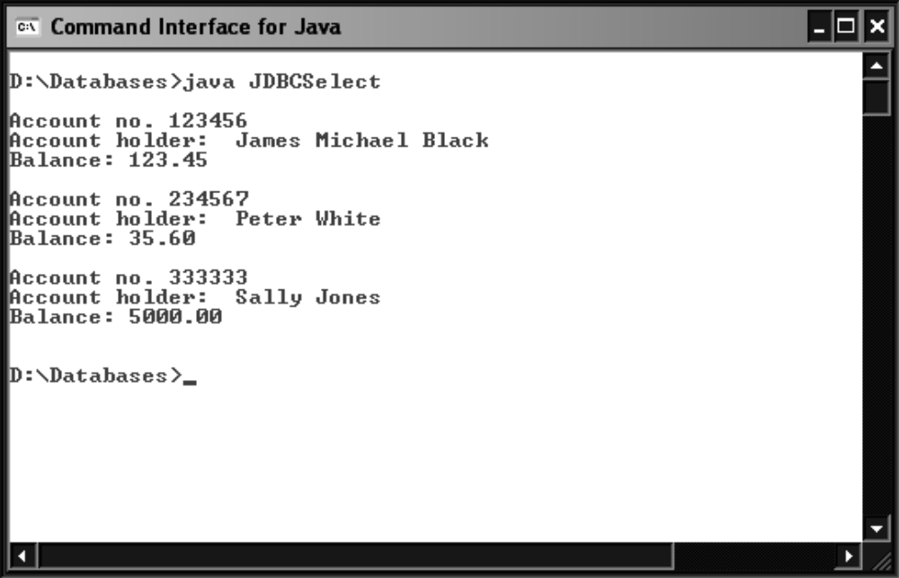

Slide 25
6.Close the Connection
This is achieved by calling method close of our Connection object and should be carried out as soon as the processing of the database has finished
con.close();
Statement objects may also be closed explicitly via the identically-named method of
our Statement object.
For example:
stm.close();

Slide 26


Slide 27
Modifying the Database Contents
INSERT, DELETE and UPDATE statements
We shall have to submit our SQL statements via the executeUpdate method
Example 1:
String insert = ("insert into Employee values(100, 'S N Rao'. 5500.50)");
stmt.executeUpdate(insert);
int result = statement.executeUpdate(insert);
if (result==0)
System.out.println("* Insertion failed! *");
Example 2:
String s2= ("update Employee set empsal=8000 where empid=101“)
stmt.executeUpdate(s2);

Slide 28
Example 3:
String s3=("delete from Employee where empid=103");
stmt.executeUpdate(s3);
String remove = "DELETE FROM Accounts"
+ " WHERE balance < 100";
result = statement.executeUpdate(remove);

Slide 29
Write JDBC program to Display the Initial Content of Account Table having the fields Account No ,Account holders Name and balance.
Perform insertion operation on Account Table
Update the Account , set the new surname and firstname for acctNum = 123456
Delete the account number with the balance<100
Display the Updated Content of Account Table.
Use MySQL DB .

Slide 30
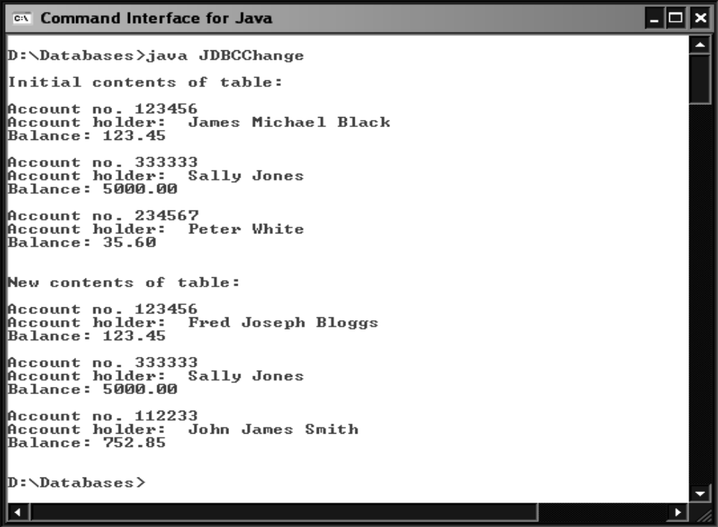

Slide 31
Write JDBC program to select the Account No ,Account holders Name and balance from MySQL DB of Account table where username=‘root’ and pwd=‘nmamit ’

Slide 32
Example…
import java.sql.*;
class Dbdemo
{
void displayinfo() throws SQLException
{
try
{
Class.forName("com.mysql.jdbc.Driver");
Connection con =
DriverManager.getConnection("jdbc:mysql://localhost/database1","root", “root");
Statement stm = con.createStatement ( );
String s = "SELECT * FROM emp";
ResultSet rs = stm.executeQuery (s);
while(rs.next())
{
System.out.println(rs.getString(1) + "\t" + rs.getString(2));
}

Slide 33
rs.close();
stm.close();
con.close();
}
catch(Exception e)
{
e.printStackTrace();
}
}
}
class Db2
{
public static void main(String args[]) throws SQLException
{
Dbdemo d1 = new Dbdemo();
d1.displayinfo();
}
}

Slide 34
Example…
import java.sql.*;
class Dbdemo
{
void displayinfo() throws SQLException
{
try
{
Class.forName("com.mysql.jdbc.Driver");
Connection con =
DriverManager.getConnection("jdbc:mysql://localhost/database2","root", “nmamit");
Statement stm = con.createStatement ( );
String s1 = ("insert into Employee values(100, 'S N Rao'. 5500.50)");
stmt.executeUpdate(s1);
String s2= ("update Employee set empsal=8000 where empid=101“)
stmt.executeUpdate(s2);

Slide 35
String s3=("delete from Employee where empid=103");
stmt.executeUpdate(s3);
System.out.println("Database updated successfully!!!!");
stm.close();
con.close();
}
catch(Exception e)
{
e.printStackTrace();
}
}
}

Slide 36
class Db2
{
public static void main(String args[]) throws SQLException
{
Dbdemo d1 = new Dbdemo();
d1.displayinfo();
}
}

Slide 37
Transactions…
A transaction is one or more SQL statements that may be grouped together as a single processing entity
If only some of the statements are executed, then the database is likely to be left in an inconsistent state.
The SQL statements used to implement transaction processing are COMMIT and ROLLBACK, which are mirrored in Java by the Connection interface methods commit and rollback

Slide 38
commit is used at the end of a transaction to commit/finalize the database changes.
rollback is used (in an error situation) to restore the database to the state it was in prior to the current transaction.
In order to change this default behavior, we must first execute Connection method setAutoCommit with an argument of false

Slide 39
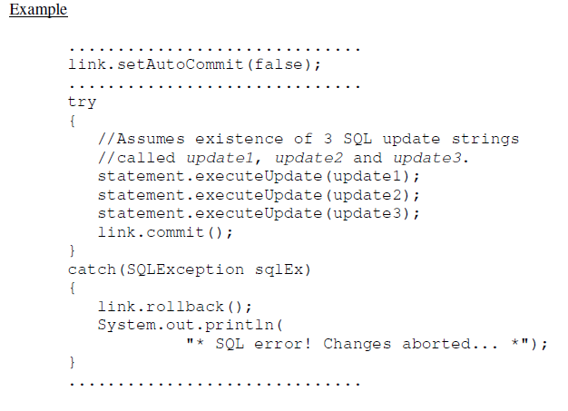

Slide 40
..............................
import java.sql.*;
class FetchRecords{
public static void main(String args[])throws Exception
{
Class.forName("oracle.jdbc.driver.OracleDriver");
Connection con =
DriverManager.getConnection("jdbc:mysql://localhost/database2","root", “nmamit");
Statement stm = con.createStatement ( );
con.setAutoCommit(false);
Statement stmt=con.createStatement();
stmt.executeUpdate("insert into Emp values(190,'abhi',40000)");
stmt.executeUpdate("insert into Emp values(191,'umesh',50000)");
stmt.executeUpdate("insert into Emp values(192,'ashi',40000)");
stmt.executeUpdate("insert into Emp values(193,‘shailesh',50000)");
con.commit();
con.close();
}}

Slide 41
Meta Data…
Meta data is 'data about data‘
There are two categories of meta data available through the JDBC API:
• Data about the rows and columns returned by a ResultSet Metadata.
• Data about the database returned by DatabaseMetaData.

Slide 42
Metadata(Cont..)
getDatabaseProductName():returns the product name of the database
getUserName( ):returns the username.
getURL():returns the URL of the database
getSchemas( ):returns the schema name
getProcedures( ):returns the stored procedure names.
getTables( ):returns names of the tables in the database.
getColumnCount( ):returns the number of columns contained in the resultset
getColumnName(int number):returns the name of the colmn specified by the column number
getColumnType(int number):Returns the data type of the column specified by the column number.

Slide 43
Scrollable ResultSets in JDBC 2
JDBC 1 did not allow any other kind of movement
only method available for moving through a ResultSet was next.
JDBC 2 in Java 2, introduced ResultSet methods:
boolean first()
boolean last()
boolean previous()
boolean relative (int <rows>)
boolean absolute(int <rows>)

Slide 44
results.relative(-3); //Move back 3 rows.
results.absolute(3); //Move to row 3 (from start of ResultSet).

Slide 45
Scrollable ResultSet
Virtual cursor can be moved backwards or even positined at specific row.
Methods
boolean first():fetch the first row.
boolean last(): fetch the last row.
boolean previous(): fetch the previous row.
boolean absolute(): fetch the row specified by the integer as a parameter.
boolean relative(): fetch the rows relatively.
int getRow():represents the number of current row in the Resultset.

Slide 46
Signature of Scrollable Resultset
following static constants in interface ResultSet:
• TYPE_FORWARD_ONLY
• TYPE_SCROLL_INSENSITIVE
• TYPE_SCROLL_SENSITIVE

Slide 47
Scrollable ResultSet
TYPE_FORWARD_ONLY:restrict the virtual cursor to downward movement.
TYPE_SCROLL_INSENSITIVE:permit the virtual cursor to move in both directions(insensitive to the changes)
TYPE_SCROLL_SENSITIVE:permit the virtual cursor to move in both directions(sensitive to the changes)

Slide 48
There are two possible values that the second argument to createStatement can take. These are identified by the following static constants in interface ResultSet:
• CONCUR_READ_ONLY
• CONCUR_UPDATABLE
first means that we cannot make changes to the ResultSet rows
whilst the second will allow changes to be made
Ex:Statement st= link.createStatement(ResultSet.TYPE_SCROLL_SENSITIVE,
ResultSet.CONCUR_READ_ONLY);

Slide 49
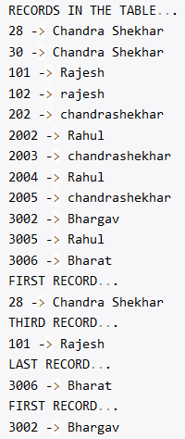

Slide 50
Modifying Databases via Java Methods
supply ResultSet.CONCUR_UPDATABLE as the second argument.
Example
Statement statement = link.createStatement(ResultSet.TYPE_SCROLL_SENSITIVE,
ResultSet.CONCUR_UPDATABLE);

Slide 51
As usual, there are three types of change that we can carry out on the data in a database:
• updates (of some/all fields of a selected row);
• insertions (of new data rows);
• deletions (of existing database rows).

Slide 52
Example
results.moveToInsertRow();
results.updateInt("acctNum", 999999);
results.updateString("surname", "Harrison");
results.updateString("firstNames",
"Christine Dawn");
results.updateFloat("balance", 2500f);
results.insertRow();

